Slide 1
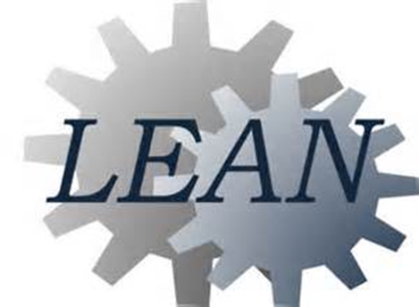
Learning To Think Lean

Slide 2
What MRHC expects from you
Do the job you were hired for to the best of your ability
Improve the way your job is being done

Slide 3
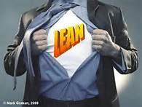
What is Lean?
Lean manufacturing, lean enterprise, or lean production, often simply, "Lean," is centered on preserving value with less work. Lean manufacturing is a management philosophy derived mostly from the Toyota Production System (TPS) and identified as "Lean" only in the 1990s.

Slide 4
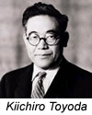
Then in the 1930s, and more intensely just after World War II, Toyoda, Taiichi Ohno, and others at Toyota looked at their situation and Ford’s concepts. It occurred to them that a series of simple innovations might make it more possible to provide both continuous process flow and a wide variety in products. From that they invented the Toyota Production System (TPS).

Slide 5
Why Lean in Healthcare?
Why implement lean into the healthcare industry
20,000 incorrect drug prescriptions per year in the US
500 incorrect surgical operations per week
50 new born babies dropped at birth per day
Enormous defect rate
Cost escalation
60%-80% of costs can be reduced
Work and patient flow will improve
Patient as well as non-patient care processes will improve
Improves morale, productivity and bottom line

Slide 6
So what is Lean in Healthcare?
“The endless transformation of waste into value from the customer’s perspective”.
Lean is not about working harder or faster, it is about finding waste and transforming it into value our customers want.
One of the important aspects of Lean Healthcare is the focus on “service-level” improvements.
Lean is about empowering employees to make decisions.

Slide 7
OUR GOAL: The perfect patient experience
Exactly what the patient needs, defect free.
One by one, customized to each individual patient.
On demand, exactly as requested
Immediate response to problems or changes.
No Waste
Safe for patients, staff and clinicians: Physically, Emotionally, & Professionally

Slide 8
Traditional Culture Vs. Lean Culture
Managers Direct
Blame people
Guard information
Volume lowers cost
Internal focus
Expert driven
Rewards: individual
Function alone
Managers Teach
Root cause analysis
Share information
Removing waste lowers cost
Customer focus
Process driven
Rewards: groups
Function as teams
Traditional Culture
Lean Culture

Slide 9
5-S System
5-S is the name of a workplace organization method that uses a list of five Japanese words. The list describes how to organize a work space for efficiency and effectiveness by identifying and storing the items used, maintaining the area and items, and sustaining the new order.
Sort
Set in order
Shine
Standardize
Sustain

Slide 10
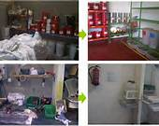
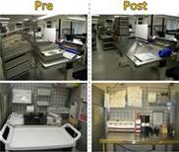
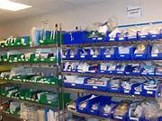
5-S in Action…..

Slide 11
5 Whys
The 5 Whys is a question-asking technique used to explore the cause-and-effect relationships underlying a particular problem. The primary goal of the technique is to determine the root cause of a defect or problem. Asking why 5 times is often useful in deterring the root cause. There is nothing magic about the number 5, just continue to ask “why” until you find a root cause of a problem.
A key phrase to keep in mind in any 5 Why exercise is "people do not fail, processes do".

Slide 12
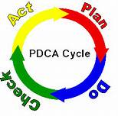
P – D – C – A
The cycle used for continuous improvement:
PLAN: Set targets/goals and plan how to get there
DO: train, learn and implement solutions
CHECK: Check the effects of what you’ve done
ACT: take action on what you’ve found….then do it all over again.

Slide 14
Value Stream Mapping
is the process of tracking a product/item/person throughout the production cycle through every process, to finished product.
It also helps companies see where the process is being slowed down and allows teams to come up with goals to eliminate the cause of the slowdown.
It pinpoints the bottom line and enables it to improve techniques that otherwise would be hard to visualize.

Slide 15
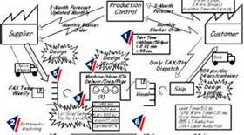
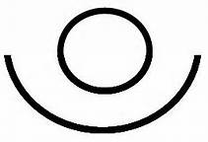
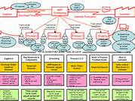

Slide 16
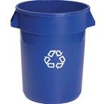
8 Types of Waste
Transporting
Overproduction
Motion
Defects/Rework
Waiting
Inventory
Processing problems/unclear
Under utilized people

Slide 17
What is Waste
Watch Video Now

Slide 18
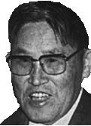
“There are four purposes of improvement:
easier, better, faster and cheaper.
These four goals appear in the order of priority.”
Shigeo Shingo

Slide 19
“It is not the strongest of the species that survive, nor the most intelligent, BUT the one most responsive to change.” Charles Darwin

Slide 20
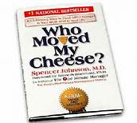
Video
Who Moved My Cheese
13 minutes
Watch Video Now

Slide 21
Life is unpredictable and you never know what is coming next. Don’t ever get too comfortable. Always be ready for change.

